Slide 1
Introduction to
Variables and Datatypes

Slide 2
Identifiers
Name assigned to a particular entity in a program.
Can be a variable name, method name, class name, structure name etc.
Variables Names
Methods Names
Identifiers
Class Names
Structure Names

Slide 3
Variables
A variable is a container which is used to store data.
A kind of identifier.
Each variable has a specific data type.
Container named “student_id” holding a value 1234
int student_id = 1234;
1234
Datatype
Variable_Name
Value
student_id

Slide 4
Variables (contd.)
Declaration: Allocating memory space while specifying the datatype of a variable.
Assignment: Assigning a value to a variable.
Initialization: Allocating memory space while specifying the datatype and assigning a value.
int a; //declaration a= 5; //assignment | int a = 5; //initialization

Slide 5
Variables Initialization
Syntax:
<datatype> <variable_name> = <value> <format_specifiers>
[Format specifiers only for double and float data type]
Example:
int number = 25; char var = ‘H’; double value = 2.56d;

Slide 6

Variable Naming Conventions
Must begin with letters (A-Z, a-z), dollar sign ($) or underscore ( _ ).
Ex: int number = 90;
Can not start with numbers or special characters.
Ex: int %name = 88;
Ex: int 1name = 70;
Can have numbers except at the start (0-9).
Ex: int num1 = 10;
Wrong

Slide 7

Variable Naming Conventions (Contd)
Case sensitive
Num1 and num1 not same
Can not contain white spaces
Can use camel casing (studentName) or snake casing (student_id) for multiple words in a variable
Ex: int given number = 20;
Ex: int given_number = 20;
Ex: int givenNumber = 20;
Wrong
Correct

Slide 8
Variable Naming Conventions (Contd)
Should be meaningful.
Single character variable names should be avoided.
Variable names must not be a Java reserved keyword.
All keywords start with lowercase letters.
abstract | assert | boolean | synchronized | byte | case | catch | char | class
continue | default | do | double | else | enum | extends | final | finally
float | for | if | implements | import | int | long | native | new
null | package | private | instanceOf | public | return | short | static | strictfp
super | switch | break | interface | this | throw | throws | transient | try
void | volatile | while | protected | const | goto | true | false | null
Fig: Reserved keywords in Java

Slide 9
Data Types
Each variables in Java must of a specific data type.
There are major two types of data in Java:
Primitive Data Types: Holds a value, specifies the size and type of a variable.
Non-Primitive Data Types: Holds a reference to an object or location.

Slide 10
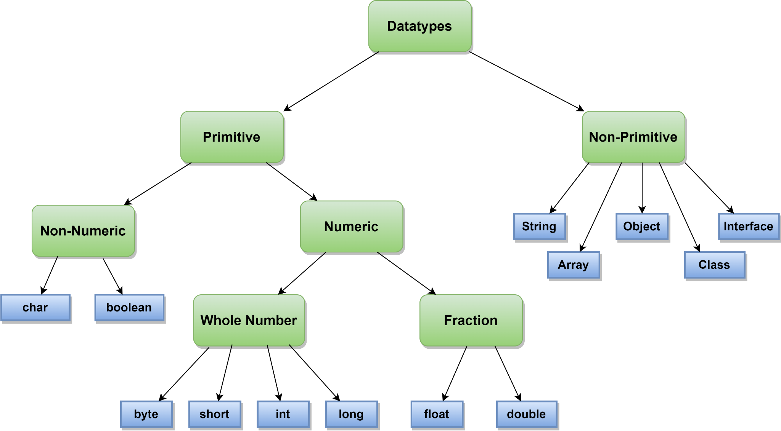
Data Types (Contd)

Slide 11
Data Types (Contd)
Data Type | Significance | Size | Range
byte | small integer | 1 byte = 8 bit | -128 to 127
short | Short integer | 2 byte = 16 bit | -32,768 to 32,767
int | Integer value | 4 byte = 32 bit | –2,147,483,648 to 2,147,483,647
long | Long integer | 8 byte = 64 bit | –9,223,372,036,854,775,808 to 9,223,372,036,854,775,807
double | Double-precision floating point | 8 byte = 64 bit | 4.9e-324 to 1.8e+308
float | Single-precision floating point | 4 byte = 32 bit | 1.4e-45 to 3.4e+38
boolean | True/ False value | 1 bit | -
char | Character | 2 byte 16 bit | -

Slide 12
Data Types (Contd)
Primitive Data Types Example:
byte value = 20;
short s1 = 1000;
long var = 2351678;
int a = 10;
float b = 1.56f; // f specifies float value
double d1 = 12.6543d; // d specifies double value
char ch = ‘a’; // Enclosed by single quotation
boolean answer = true;

Slide 13
Data Types (Contd)
Non-primitive Data Types Example:
String: A sequence of characters surrounded by double quotes.
  Example:
String my_string = “Hello World”;
Arrays: Collection of a fixed number of values of similar data type.
  Example:
int [ ] arr1 = {24, 9, -11, 5};

Slide 14
Check Carefully!!!
Values of char datatype are enclosed in single quotation (‘).
But values of String datatype are enclosed in double quotation (”).
Example:
    char ch = ‘a’; // Enclosed by single quotation
    String my_string = “Hello World”; // Enclosed by double quotation

Slide 15
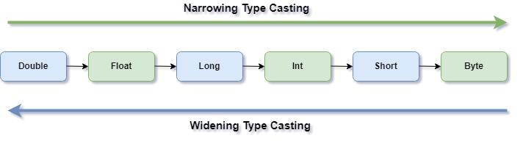
Datatype Conversion/ Type Casting
casting is the process of changing an entity's data type to another datatype. Moreover, type casting is the process of converting a value between two different data types.
Only the data type can be changed by casting; the data itself cannot be changed.
Two types of Casting:
  Widening/Implicit Casting
  Narrowing/Explicit Casting

Slide 16
Widening/Implicit Casting
Converting a lower data type to a higher data type.
No data loss
Java does this casting automatically and without explicit coding.
Example:
int num = 10;
double data = num;

Slide 17
Narrowing/Explicit Casting
converting higher data types into lower data types.
convert larger size data types into smaller ones, data loss occurs
Example:
double num = 10.99;
int data = (int)num;

Slide 18
Numeric to Numeric Conversion
Int to double/float:
int num = 10;
double data = num; //10.0
float data2= num; //10.0
double and float to int:
double num = 10.99d;
float num2 = 10.25f;
int data = (int)num; //10
int data2= (int)num2 //10
Widening/Implicit
Narrowing/Explicit

Slide 19
Numeric to Non-Numeric Conversion and vice versa
integer to String:
String x= String.valueOf(15);
String y= Integer.toString(20);
System.out.println(x+y); //1520
String to Integer:
int n = Integer.parseInt("25");
int m = Integer.valueOf("35");
System.out.println(m+n); //60

Slide 20
Numeric to Non-Numeric Conversion and vice versa
integer to char:
int a=65;
char c=(char)a;
System.out.println(c); //A
char to Integer:
char a='Z';
int c=(int)a;
System.out.println(c); //90
ASCII Table: https://www.cs.cmu.edu/~pattis/15-1XX/common/handouts/ascii.html

Slide 21
THANK YOU!

